Slide 1
Using Machine Learning to Detect Falls In Real Time
By Danylo Krywyj, Reece Wareham and Fuhad Owolabi

Slide 2
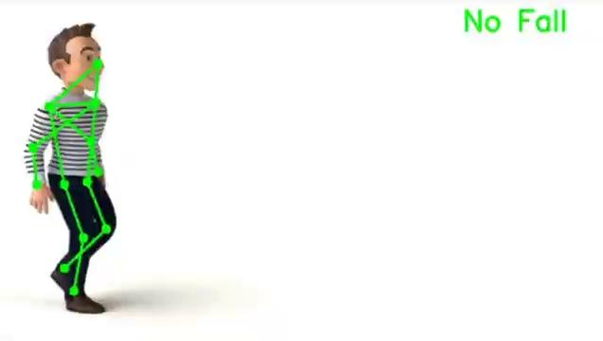
Introduction
This project aims to develop a real-time fall detection system using machine learning algorithms.
The data that we collected and used in this project is a combination of both real life footage of people falling and also video footage from video games.
The ultimate goal of this project is to use machine learning to provide timely assistance to individuals who experience falls, particularly elderly individuals living alone, by automatically triggering alerts to caregivers or emergency services.

Slide 3
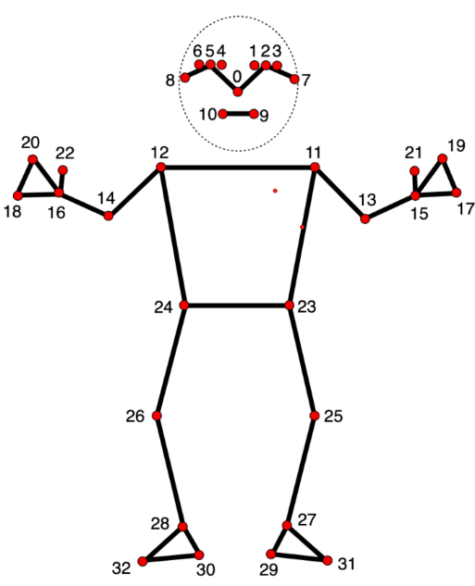
Outcomes of the Project
Compiling Dataset - We compiled our own dataset from various sources including real life footage and game footage.
Automated Pose Detection Tool - Using ‘mediapipe’ and ‘opencv’ to efficiently automate human pose detection in videos/ images, by identifying key landmarks and creating organised, datasets for broader applications.
Automated Annotation Merging Tool - This tool merges the extracted landmark data from CSV files with external annotations from CVAT, creating a new CSV file that integrates annotations with pose landmark data .
Fall Detection Model - A Support Vector Machine model was trained on the merged CSV files with an outcome of 93% accuracy after backtesting.
Fall Detection System Prototype - Using external videos and live camera, we tested our models capability outside of its training data.
Notes:
List outcomes and explain briefly each of them. 5 max
Main outcome of our projects
We compiled our own diverse dataset with real life videos/ Game videos
We implemented media pipe pose to extract specific pose landmarks
We discovered ways of implementing that data into training data
We used that data to train a model
Video of landmark extraction
Video of CVAT video of landmark /cvat merging
Screenshot merged dataset
Screenshot of model accuracy
Live camera presentation

Slide 4
Initial Proposal vs Final Prototype
The initial proposal for this project was to create a machine learning prototype that has the capability to detect a person falling from video footage. Initially, this was quite vague and didn’t give us lots to work with including not providing us with a dataset already, therefore we expanded on this idea by setting ourselves the following goals:
Gathering video footage for use in a dataset. This mainly consisted of forward falls to keep the scope manageable.
Properly labelling the dataset and prepare it for machine learning algorithms.
Evaluating and comparing machine learning algorithms to find the best accuracy.
The final prototype we are demonstrating today completes all of these established goals of the project including some extras that were added throughout the project such as detecting in real time. In its final state, the prototype is a support vector machine that has been trained using video footage we have gathered and labelled. Our prototype also includes an experimental notification system that notifies a user when a fall has been detected. Lastly, the prototype works in real time and can be used in combination with camera systems.

Slide 5

Using Game Footage For Fall Detection
Due to the limited amount of suitable data of people falling over, we had to find new ways of gathering data that we could collect in abundance. One of the main sources we used to get data is using game footage of characters falling over.
The main game we sourced this data from was Grand Theft Auto V due to its useful ragdoll physics that somewhat accurately represent people falling over in real life. To make the characters ragdoll when needed, we used a mod called Ragdoll on Demand.
This was useful because we were able to gather large amounts of data very quickly by recording high quality footage of the characters falling over which allowed us to expand out dataset very rapidly. Without the use of game footage, our dataset would have been very small leading to a less accurate model.

Slide 6
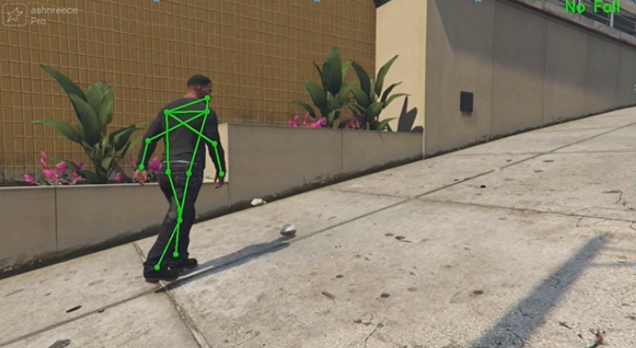
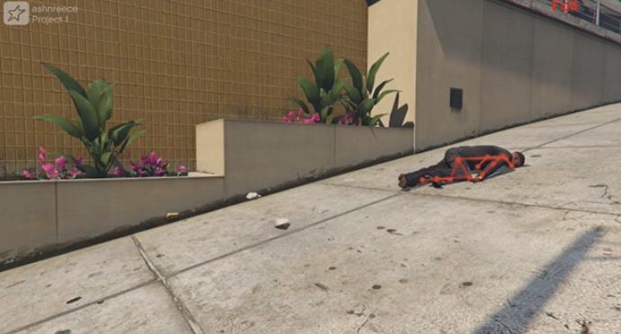

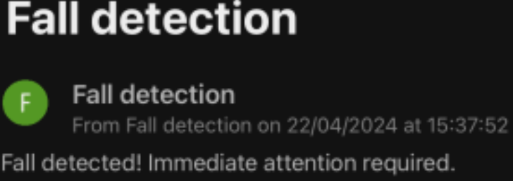
Our Prototype
No Fall Detected
Fall Detected
Alert notification sent
Alert received on mobile
Person receives assistance

Slide 7
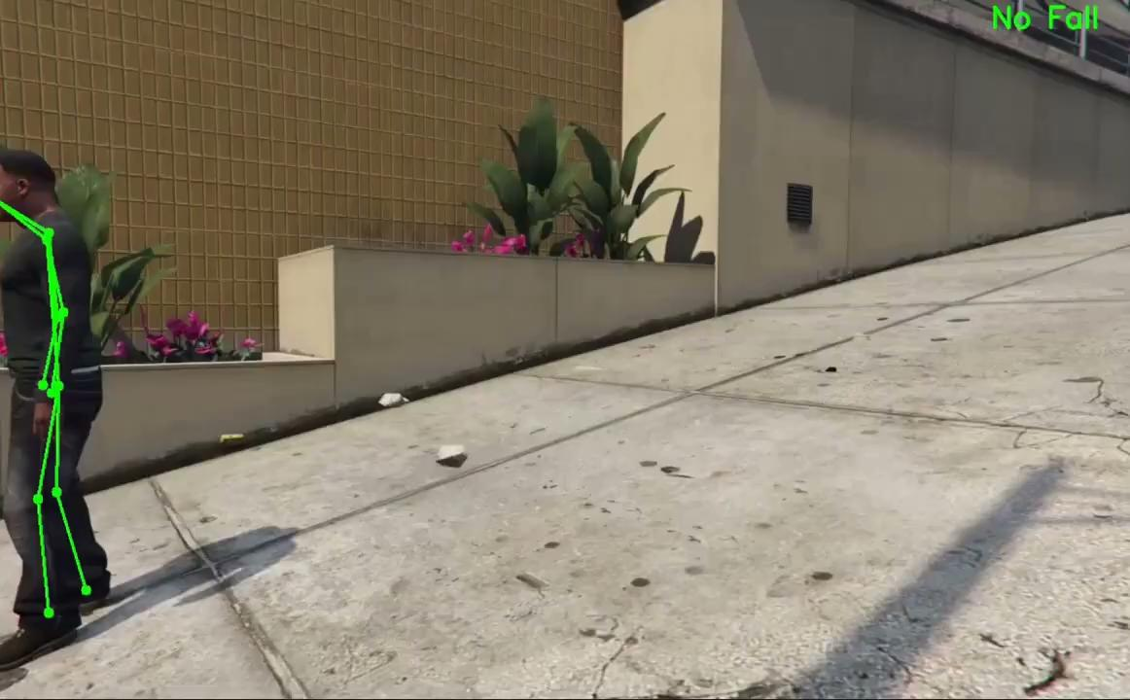
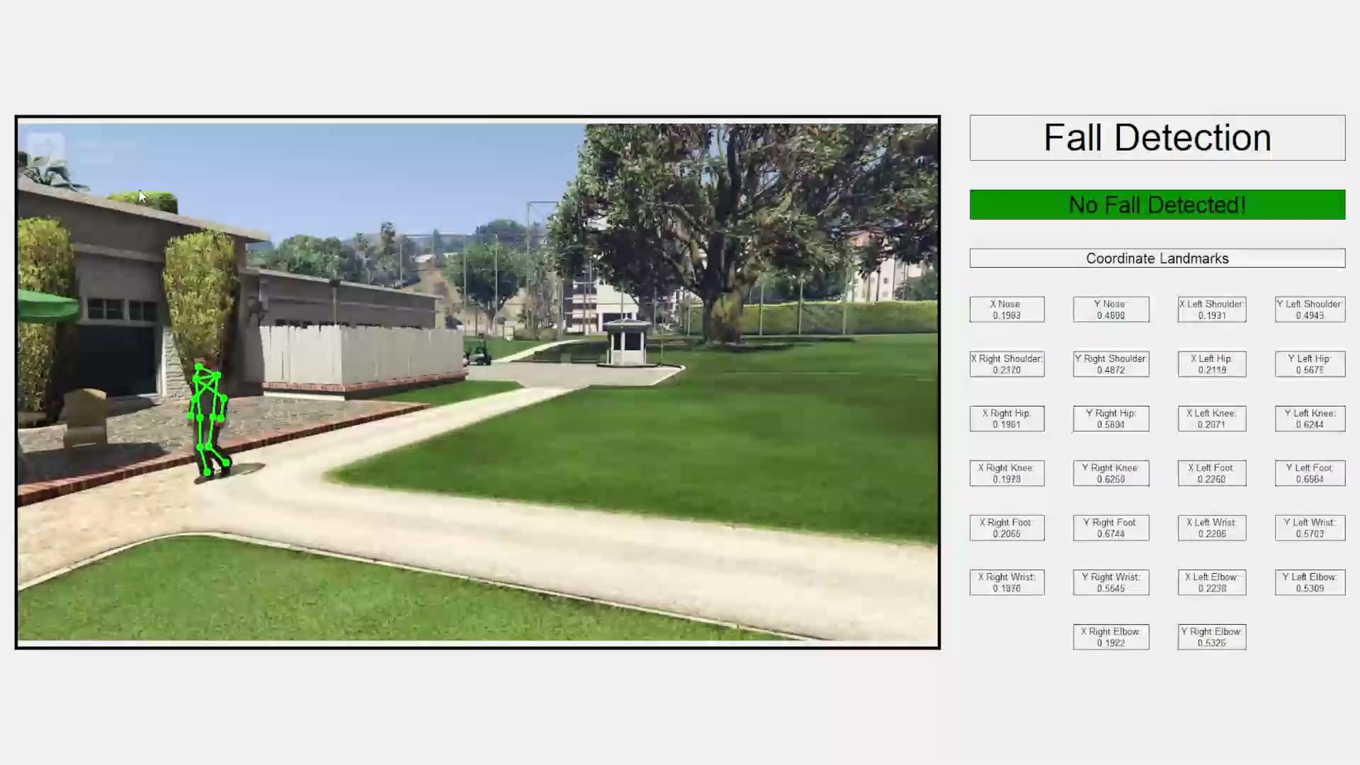
Fall Detection

Slide 8
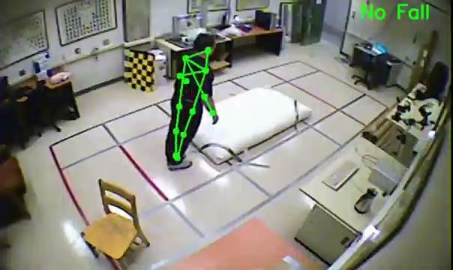
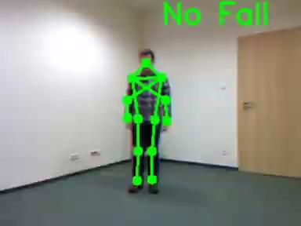
Limitations of our Model
Notes:
Limitations within the data
We were only able to track 1 person at a time

Slide 9
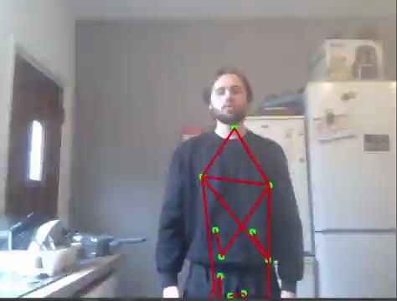
Live Camera Demonstration
One of the newer goals of our project was to detect falls in real time using cameras. We experimented with using our phone cameras with an app called DroidCam to access the camera wirelessly and transferring the camera feed into Python where we then could use OpenCV to manage the video feed to detect falls.
This experiment proved to be successful as we were able to detect poses and use the landmarks from the poses to detect falls in real time.

Slide 10
Further Work
Although the project is in a good state at the moment, they are still some improvements that could be made in the future to create a better detection system. This includes:
Gathering more data for training to increase accuracy.
Experimenting with detecting more types of falls such as falling backwards.
Making a more user friendly interface for people to use the detection system.
Allowing for a larger range of cameras to work with the system.

Slide 11
Q&A

Slide 12
Thank you for listening!

